Slide 1
Biometric UX
Interpret Graphs
Week 12

Slide 2
Recap
In Week 10
  Non Parametric test
    Hypothesis testing process
    Non Parametric tests
    Chi-Squared Test
    Mann-Whitney U
    Wilcoxon Signed Rank
This week (week 12)
  Biometric UX
  Interpret graphs

Slide 3
How can we study emotions in UX
Self-reported data (questionnaires)
Biometric UX studies that involve using various physiological and behavioural measurements to understand and improve user experiences with products, interfaces, or services.

Slide 4
What data to collect related to emotions/how can we collect it?
 | Self-report | Eye tracking | Galvanic Skin response | Facial expressions | Electrocardiography | Electroencephalography | Verbal expressions
Engagement | ✓ | ✓ | ✓ | ✓ | ✓ | ✓ | ✓
Trust | ✓ |  |  |  |  |  | ✓
Confidence | ✓ |  |  |  |  |  | ✓
Joy | ✓ |  |  |  |  |  | ✓
Frustration | ✓ |  |  | ✓ |  |  | ✓
Stress | ✓ |  | ✓ |  | ✓ |  | ✓
Suprise | ✓ |  |  | ✓ |  |  | ✓

Slide 5
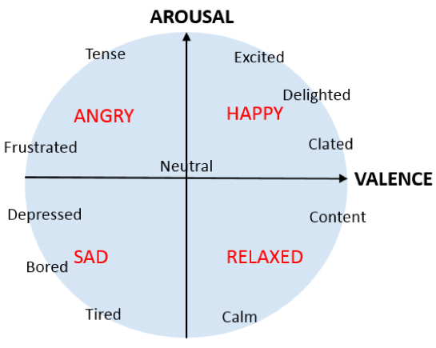
Two aspects of emotions
Arousal and Valence
Emotional valence describes the extent to which an emotion is positive or negative, whereas arousal refers to its intensity, i.e., the strength of the associated emotional state (Feldman Barrett & Russell, 1999; Lang, Bradley, & Cuthbert, 1997; Russell, 2003).
Russell, J.A. A circumplex model of affect. J. Personal. Soc. Psychol. 1980, 39, 1161

Slide 6
Biometric UX
In UX studies, various types of biometric data can be utilized to understand user behaviour, emotions, and interactions with a product or interface:
  Eye Tracking
  Gaze Tracking
  Facial Expression Analysis
  Galvanic Skin Response (GSR)
  Heart Rate Monitoring
  Electroencephalography (EEG)
  Verbal Expressions

Slide 7

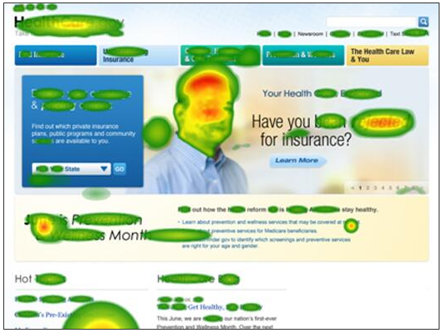
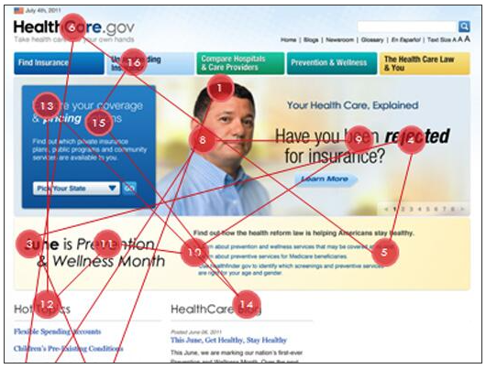
Eye Tracking
  Eye tracking tracks where and for how long a user looks at specific elements on a screen.
  What do they notice
  How long do they look at it
  What do they see first
  What don’t they notice
  Measurement of eye activity

Slide 8
Eye tracking in UX
This helps in understanding visual attention, focus, and navigation patterns
Gaze Patterns: Eye-tracking reveals the specific areas of a screen that users focus on, how long they dwell on particular elements, and the sequence in which they view different parts of a webpage or interface.
Heatmaps: By aggregating gaze data from multiple users, heatmaps are generated to visualize areas of high and low visual attention. This helps identify which areas draw the most attention or are being overlooked.
Navigation and Information Processing: Eye-tracking studies can reveal how users navigate through menus, buttons, or content hierarchies. It helps in understanding how users scan information, process it, and make decisions.
Usability and Design Evaluation: It helps in evaluating the effectiveness of design layouts, identifying areas of confusion or distraction, and optimizing the placement of elements for better user engagement.
Visual Hierarchy: Eye tracking assists in understanding how users perceive the visual hierarchy of a design—what elements stand out, how they prioritize information, and what draws their attention first.
Attention and Engagement: It provides insights into user engagement levels by measuring the duration and frequency of fixations on specific elements. This helps in assessing user interest and involvement.
Comparative Studies: Eye tracking can compare different design variations to determine which version performs better in terms of attracting and retaining user attention.
Notes:
Gaze Patterns: Eye-tracking reveals the specific areas of a screen that users focus on, how long they dwell on particular elements, and the sequence in which they view different parts of a webpage or interface.
Heatmaps: By aggregating gaze data from multiple users, heatmaps are generated to visualize areas of high and low visual attention. This helps identify which areas draw the most attention or are being overlooked.
Navigation and Information Processing: Eye-tracking studies can reveal how users navigate through menus, buttons, or content hierarchies. It helps in understanding how users scan information, process it, and make decisions.
Usability and Design Evaluation: It helps in evaluating the effectiveness of design layouts, identifying areas of confusion or distraction, and optimizing the placement of elements for better user engagement.
Visual Hierarchy: Eye tracking assists in understanding how users perceive the visual hierarchy of a design—what elements stand out, how they prioritize information, and what draws their attention first.
Attention and Engagement: It provides insights into user engagement levels by measuring the duration and frequency of fixations on specific elements. This helps in assessing user interest and involvement.
Comparative Studies: Eye tracking can compare different design variations to determine which version performs better in terms of attracting and retaining user attention.

Slide 9
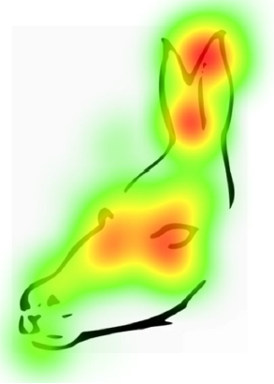
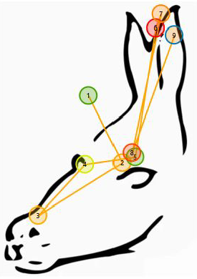
Scanpaths and heatmaps
Individual vs. aggregated data
Scanpaths show the individual respondent’s eye tracking data.
Tell you the order in which a single person explored the content.
Help understand the individual user journey.
Carry information about sequences, but only at the individual level.
Can be reviewed dynamically as well as a static gaze plot.
Heatmaps are an aggregation, the sum of all respondents’ eye tracking data.
Tell you where most attention was paid to.
No information about quantities or sequences.
Purely qualitative visualization.

Slide 10
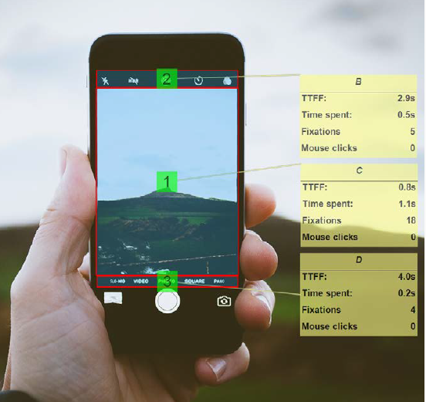
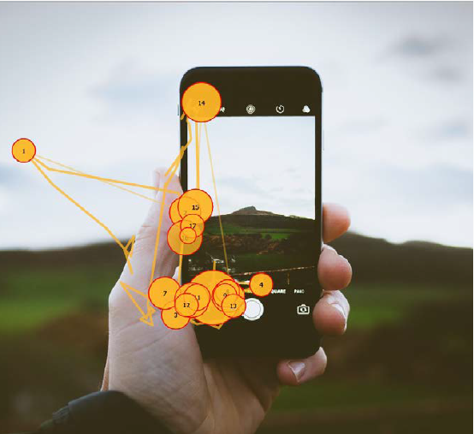
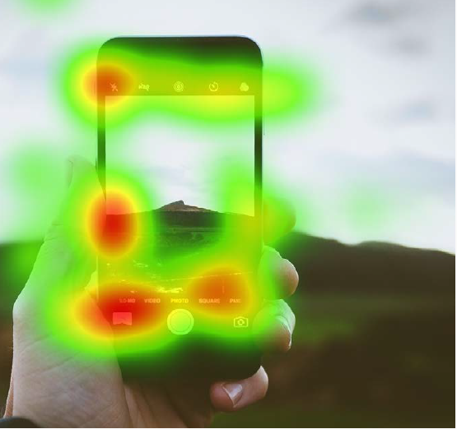
Eye tracking metrics
What are common AOI (Ares of Interest) metrics and what do they mean?
  Time to first fixation (TTFF)/ Hit time: Time lapse until the AOI was seen the first time
  Dwell time: Time spent looking at the AOI
  Fixation counts and average duration of fixation: How many fixations it took to take in information, and how long they were
  Revisits: How often respondents looked back to the AOI
  Ratio: Percentage of respondents who looked at the AOI at all

Slide 11
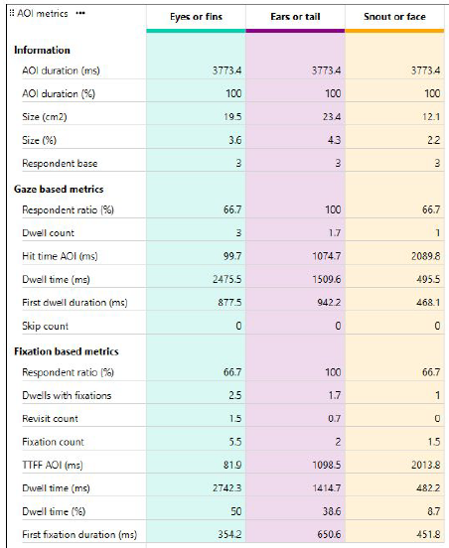
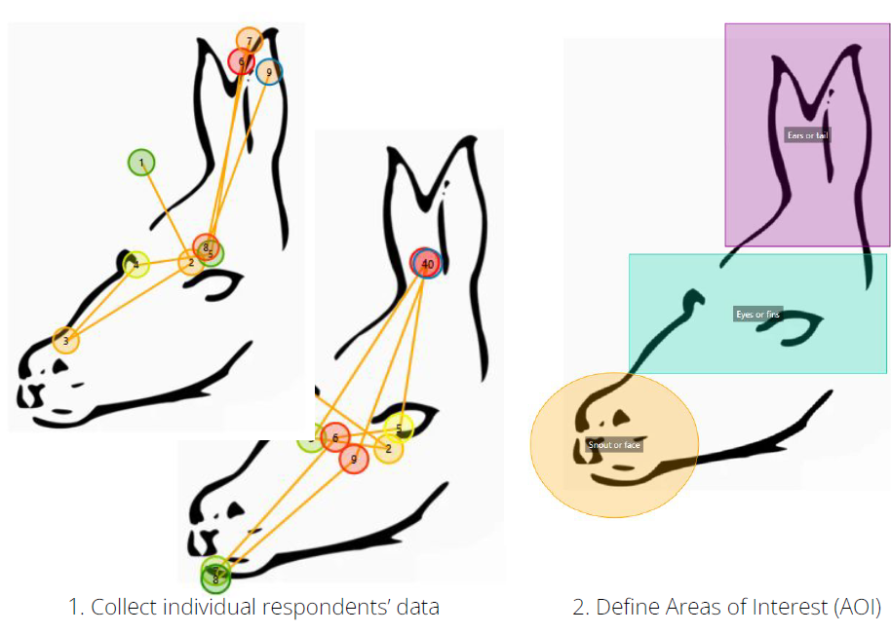
Quantifying eye tracking data through AOIs
From gaze recordings to actual metrics

Slide 12
In which fields we use eye tracking
Usability and UX
Interface design
Marketing
Product testing
Newspaper design
E-commerce optimization
Architecture and wayfinding
Driver safety
Human Factors in Engineering
Medical/ clinical diagnostics
Reading research
Psychology
Neurosciences
Infant studies

Slide 13
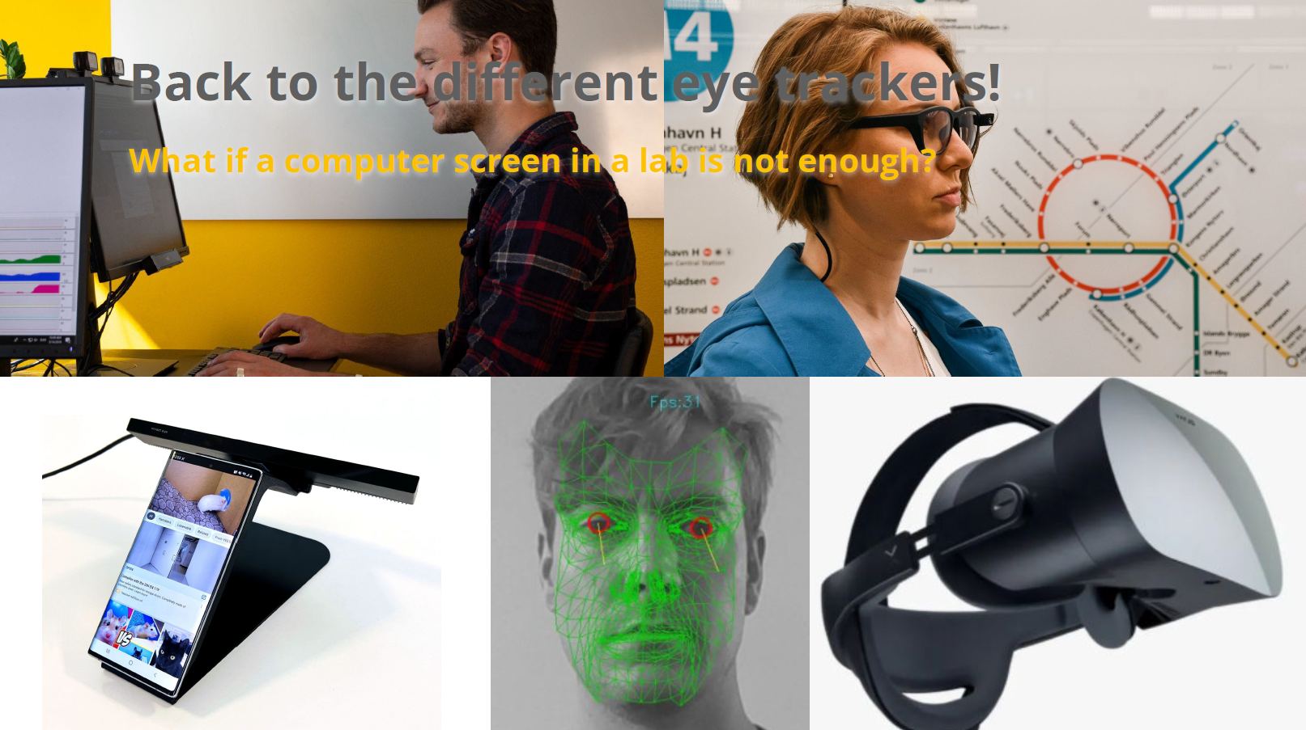
What do we need for an eye-tracking study
Notes:
Eye tracking camera
If we don’t look at a screen we may need glasses
If we use mobile we may need a stand
If we use VR we need a headset with integrated eyetracking
Corresponding software

Slide 14

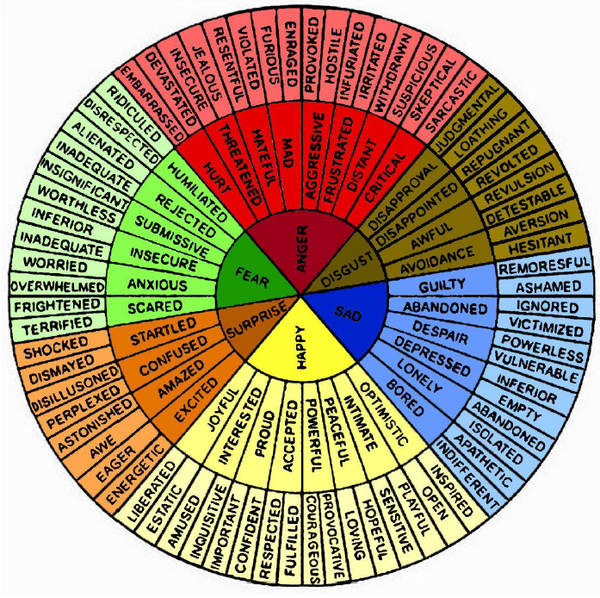
Facial Expression Analysis (FEA)
  It involves analyzing facial expressions through cameras to gauge emotions like happiness, frustration, confusion, etc., while users interact with a product or interface.
  Emotions are complex
  Measure what is expressed
  Individual differences in expression
  How can we study intensity of emotion
  Cultural and professional training - “Display rules”

Slide 15
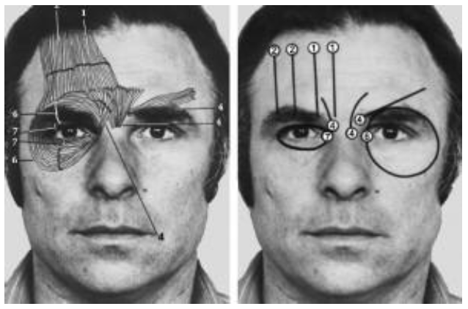
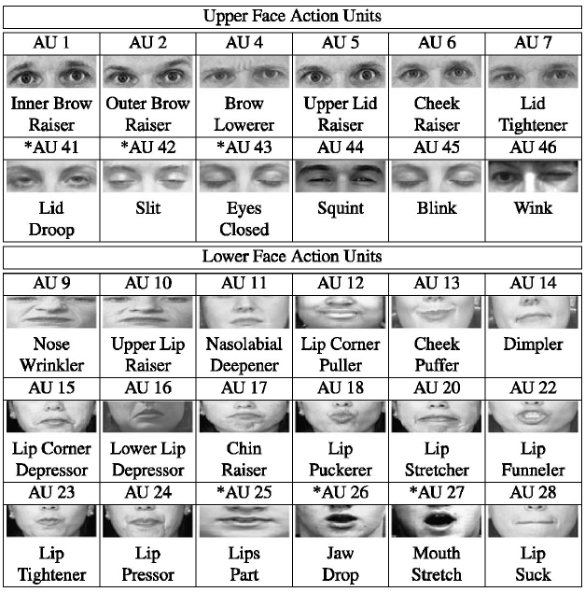
Facial Action Coding System (FACS)
Facial Action Coding System identified action units by studying the relationship between facial muscle movements and expressed emotions
Ekman and Friesen (1967, 1969) conducted studies across cultures and found relationships between distinctive facial movements and emotions.
Expressed and perceived emotions (e.g. “how do you look when friends come over”).
Differences in cultures and social settings because of display rules.

Slide 16
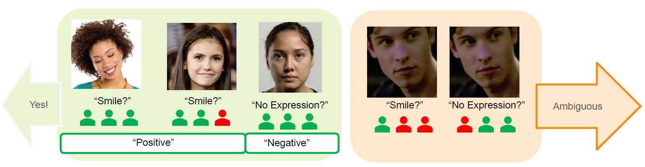
How facial expression algorithms are trained
Large and diverse dataset
  6 million faces from large number of countries (above 85)
  Pick 55,000 representative videos
Rooted in the FACS system
  Coders are FACS Certified
Outputs 7 core emotions
  Universal stand for emotion-research
Each frame of video is analyzed by 3 FACS-certified human coders
  Frame is used as training data if:
  at least 2/3 coders agree on an action unit or expression
  3/3 detect “no expression”

Slide 17
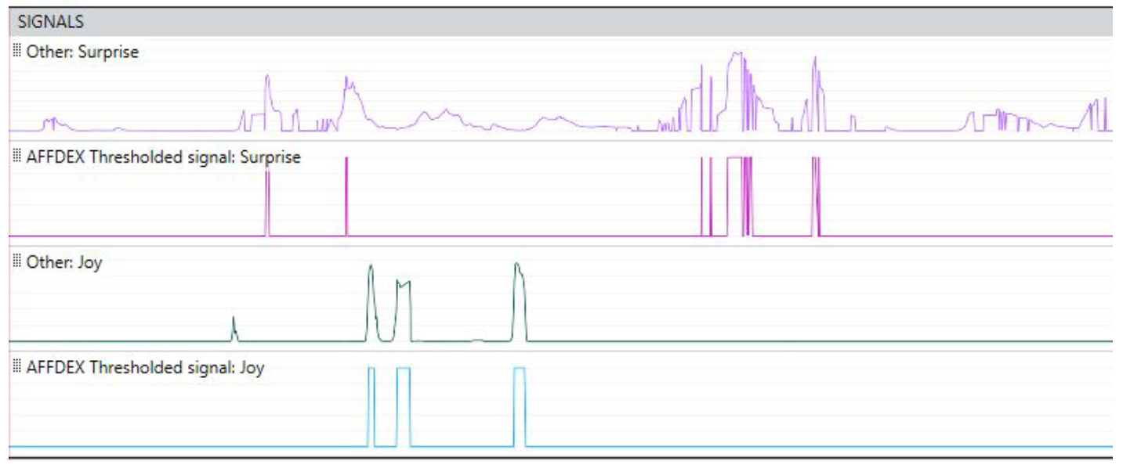
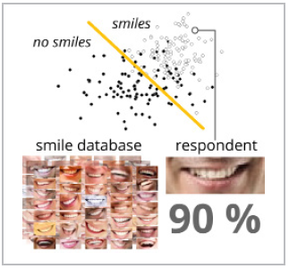
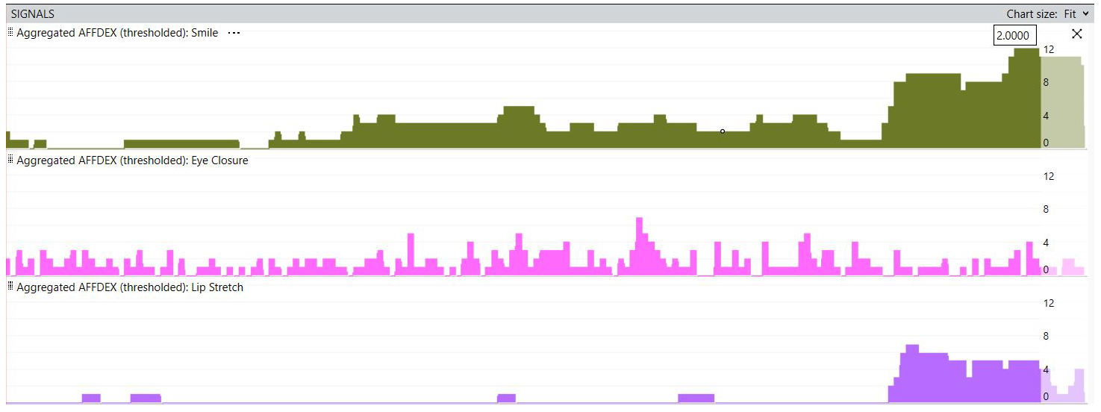
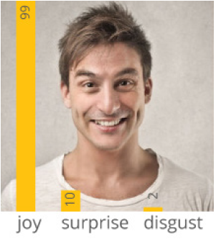
Facial expression algorithms today
What FEA do:
  Detect a face
  Detect a facial landmark
  Track changes
AFFECTIVA iMotions
  Detect action units (AU)
  Use AUs to compute expressions
  Confidence Scores: Likelihood of expressed emotion (+ head position, attention, valence, engagement)
Raw data
Aggregate data

Slide 18
What do we need for a facial expressions study?
Cameras similar to eyetracking and corresponding software

Slide 19

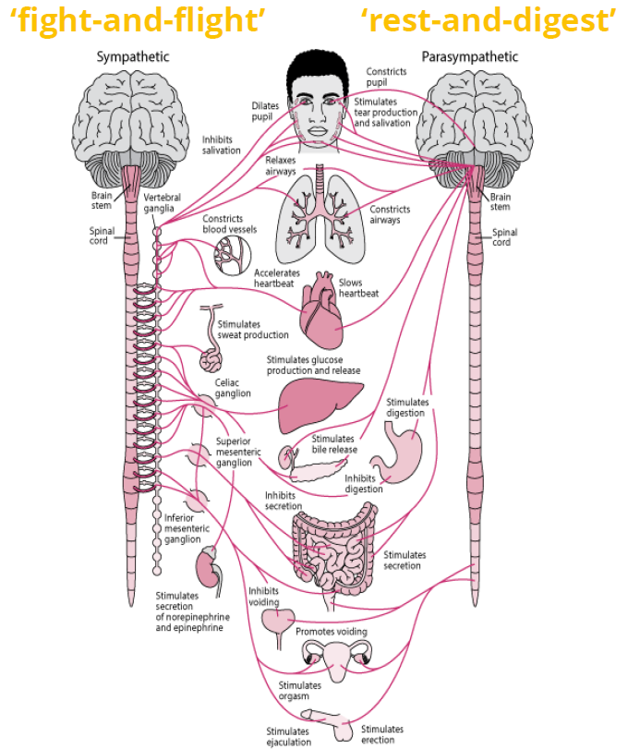
Galvanic Skin Response (GSR)
Galvanic Skin Response (GSR) also known as Electrodermal Activity (EDA) measures changes in the skin's electrical conductivity, which can indicate emotional arousal or stress levels during user interactions.
Our autonomic nervous system controls the activity of sweat glands along with our heart rate and pupil dilation
Our skin is an open book!
No matter whether we are stressed, nervous, fearful, psyched up, stoked, baffled, or surprised - whenever we are emotionally aroused, the electrical conductivity of our skin subtly changes.
Watch the video
Notes:
Sympathetic Nervous System:
Known as the "fight or flight" system, the sympathetic nervous system prepares the body for action during stressful or emergency situations.
When activated, it increases heart rate, dilates pupils, redirects blood flow to muscles, and stimulates the release of adrenaline and noradrenaline, preparing the body for a rapid response.
Functions associated with the sympathetic nervous system include increasing alertness, boosting energy, and heightening bodily functions to deal with perceived threats or stressors.
Parasympathetic Nervous System:
Often referred to as the "rest and digest" system, the parasympathetic nervous system promotes relaxation and recovery.
It works in opposition to the sympathetic system, helping the body return to a state of balance (homeostasis) after the stress response.
The parasympathetic system slows heart rate, constricts pupils, enhances digestion and nutrient absorption, and promotes relaxation responses, conserving energy and aiding in recovery.

Slide 20
What do we measure
GSR measures the increase in the electrical conductance of the skin (a decrease in resistance)
GSR signals measure internal arousal states towards certain types of stimuli and environments
GSR signals are slow! They take 1-5 seconds to be elicited. A stimulus should not be lower than that!
GSR indicates the intensity of emotional reaction and/or aroused alertness – not the valence
For valence, pair it with other technologies (Facial expressions, Brain activity) or based on the context. Let’s talk about it if you have specific ideas!

Slide 21
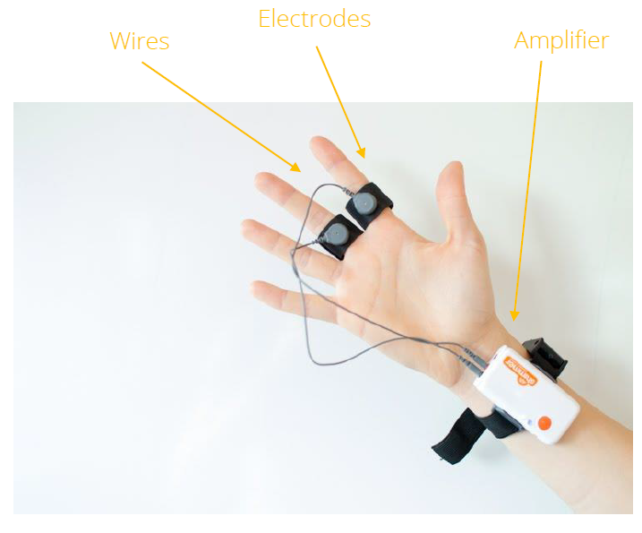
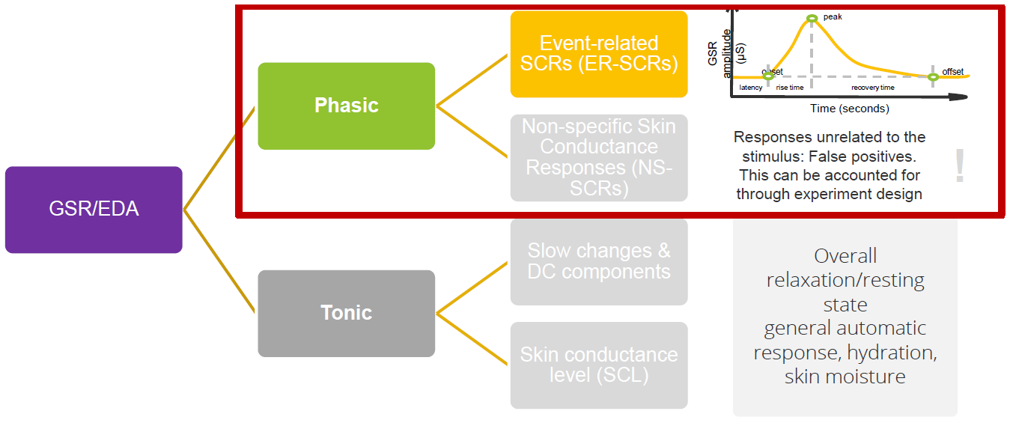
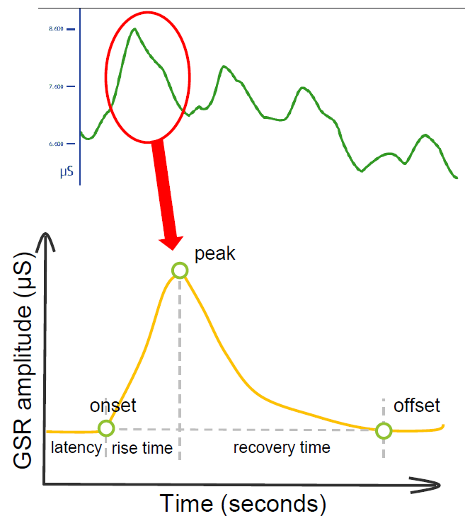
How do we measure GSR
GSR peak count
GSR peaks/min
GSR peak amplitude(in µSiemens)
GSR Signal Quality (in decibels)
GSR signals are slow!
The latency is around 1- 5 seconds

Slide 22
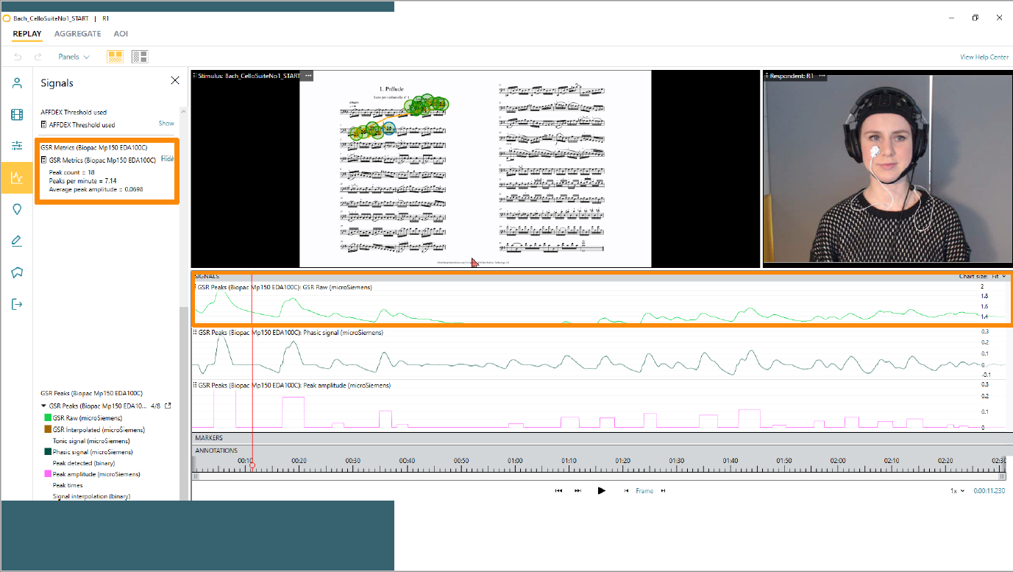
Example

Slide 23
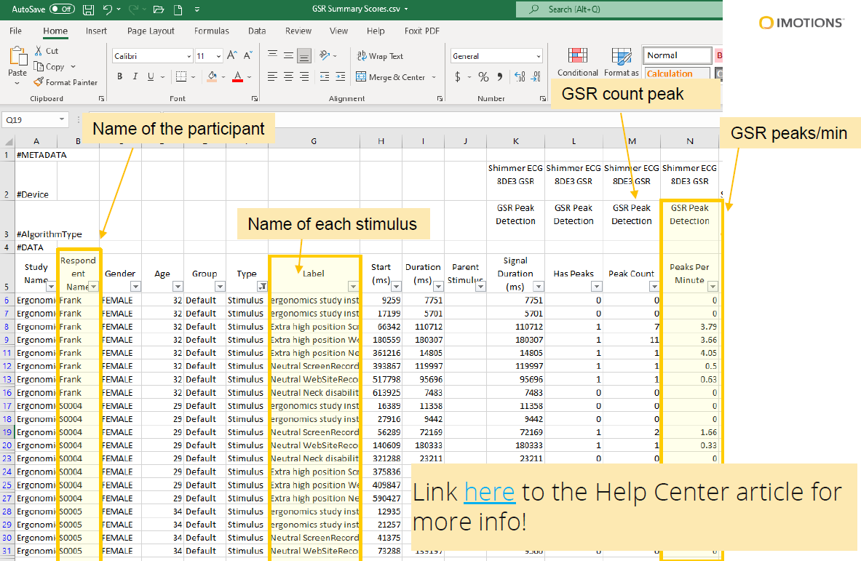
Example

Slide 24

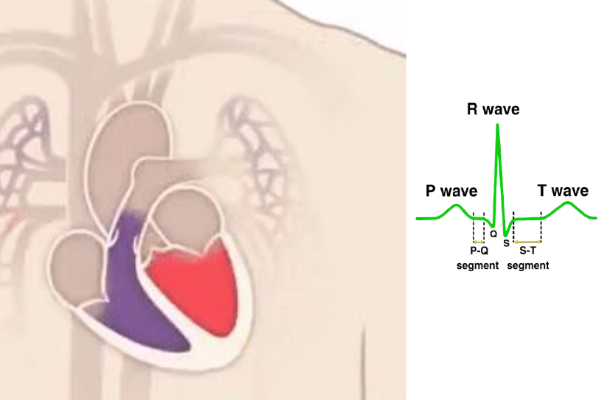
Electrocardiography (ECG)
  Electrocardiography is the measurement of electric activity of our heart
Watch the video

Slide 25
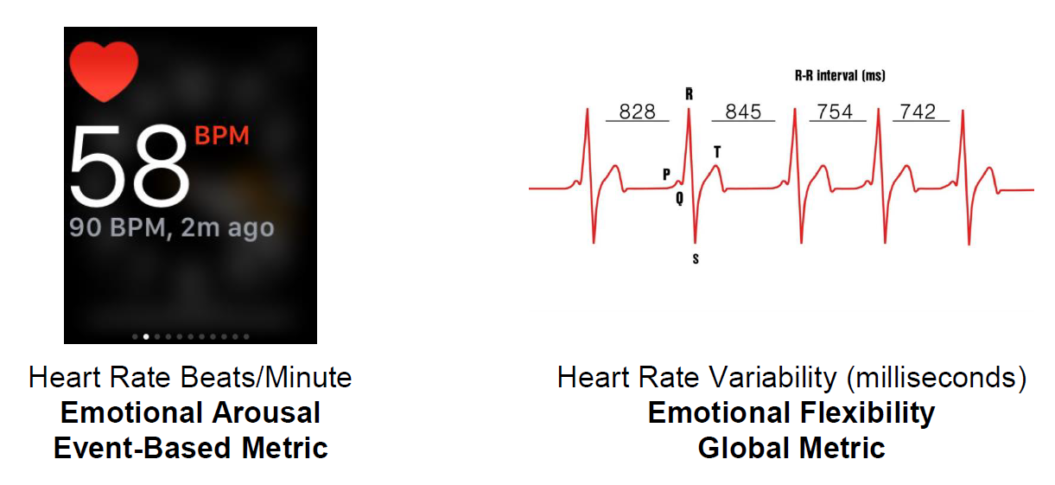
What do we measure
Two metrics
Heart Rate (HR) and Heart rate variability (HRV) are a measure of
Stress, anxiety, arousal
to determine physiological or emotional states and cognitive expenditure

Slide 26
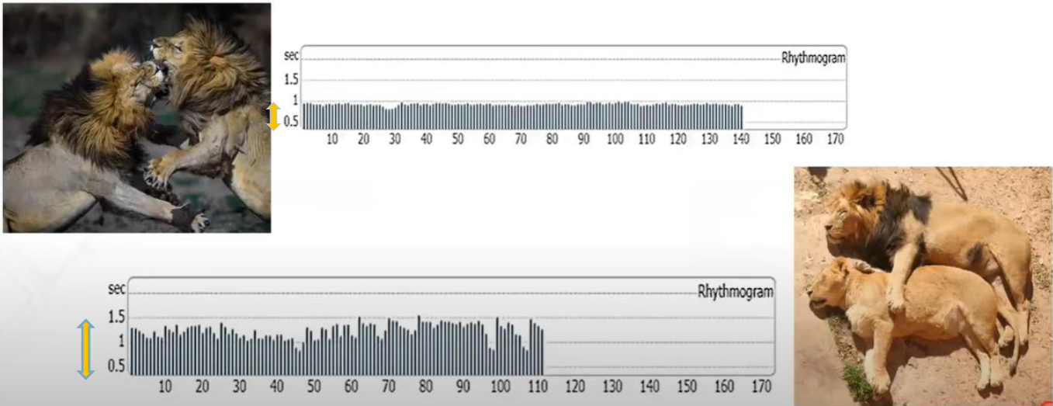
What the variability of our heart looks like?

Slide 27
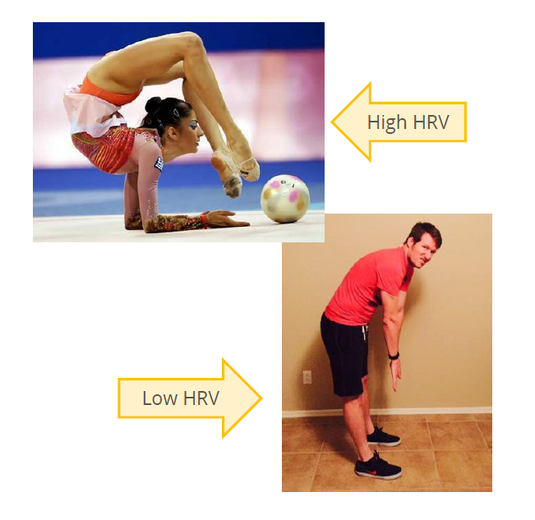
Heart Rate Variability (HRV) is an indicator of emotional flexibility
Regulating emotions in everyday life requires that the nervous system switches between high and low arousal states – modulate HR –relatively quickly
This switching is due to the delicate push-pull between the sympathetic & parasympathetic nervous systems, and is reflected as variability in heart rate
Thus, HRV is an indicator of emotional flexibility – the ability to regulate emotions on a momentary basis

Slide 28
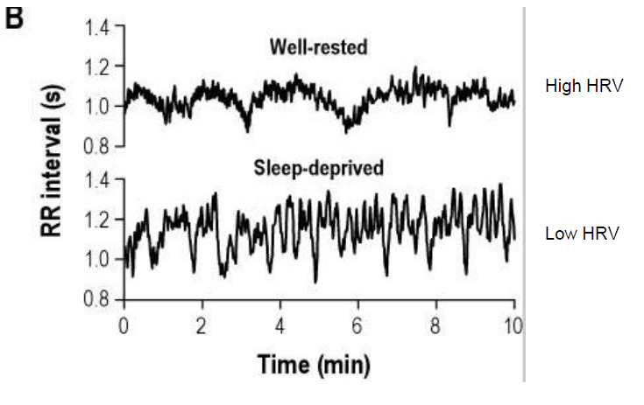
Drowsiness
HRV can also change in relation to arousal/drowsiness
Cognitive load - the lower the HRV during a period of time, the higher the cognitive load

Slide 29
In what test conditions heart rate variability give appropriate results
Heart rate variability is a global metric that characterizes an individual during a period of time
One example: Using HRV in driving
  Not applicable: Using HRV for a short test that takes 1 minute to complete or to assess stress responses when getting cut off in traffic (event-based)
  Applicable: Using HRV to determine the level of cognitive load during a cognitive test that takes a minimum of 5 minutes to complete or to characterize drowsiness with prolonged driving (global state)

Slide 30
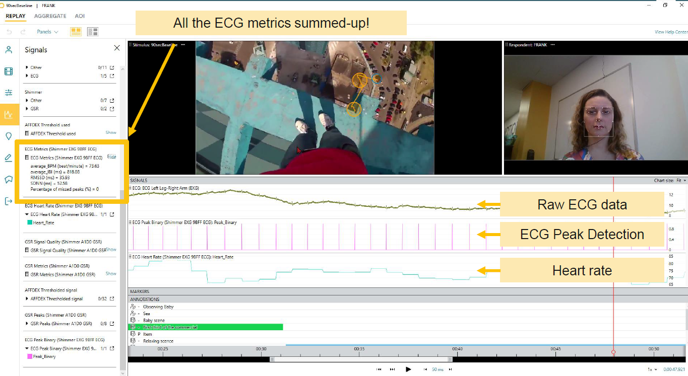
Example VR experience of heights

Slide 31
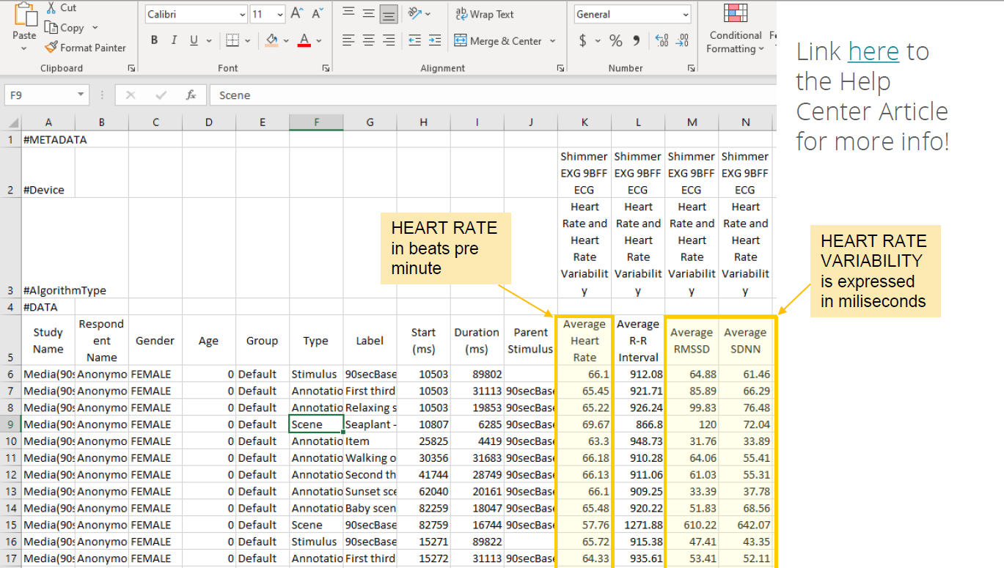
Example VR experience of heights

Slide 32
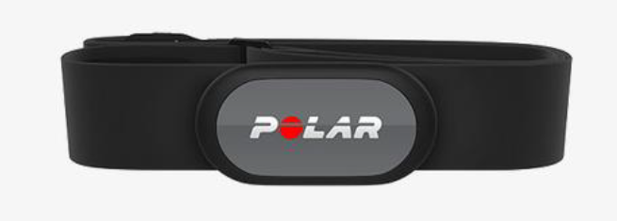
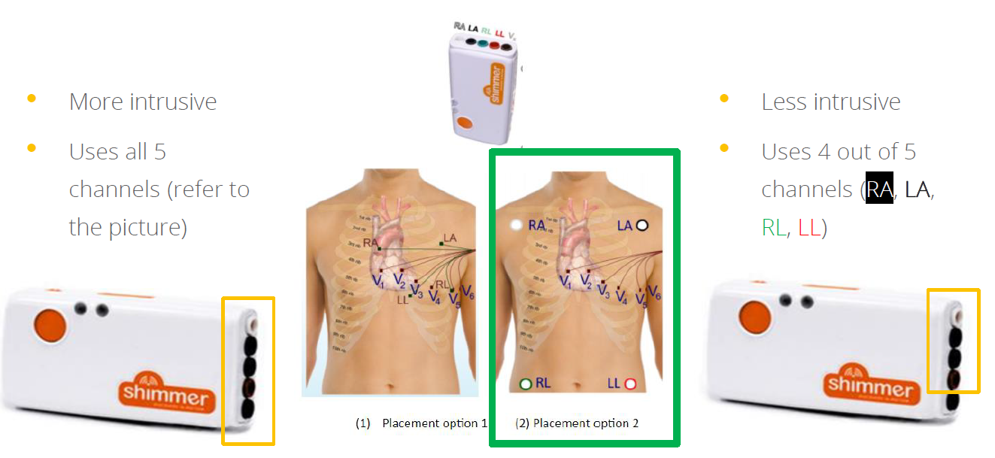
What sensors?

Slide 33
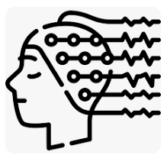
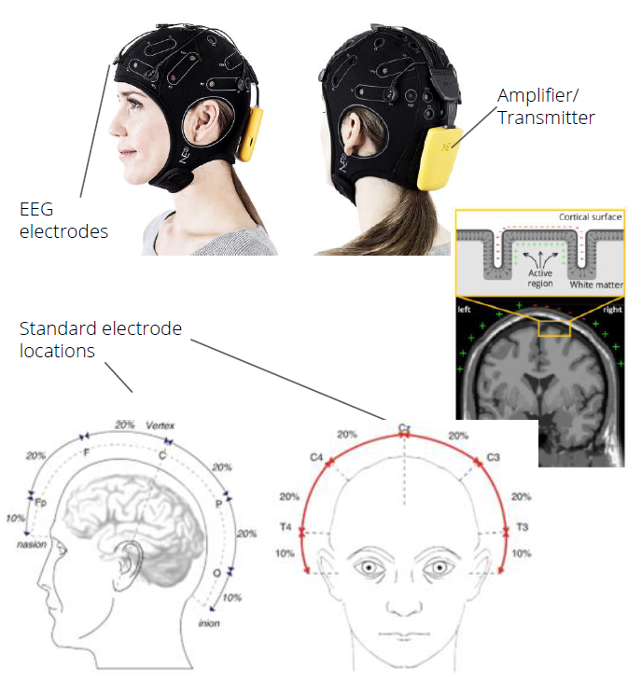
Electroencephalography (EEG)
  Electroencephalography (EEG): EEG measures brain activity and helps understand cognitive load, attention, and emotional engagement while interacting with a product.
  Brain activity involves electrical activity
  EEG sensors consist of electrodes on the scalp, which can record brain activity
  EEG electrodes measure electrical potential/voltage (in microvolts)
  EEG detects voltage changes caused by brain activity

Slide 34
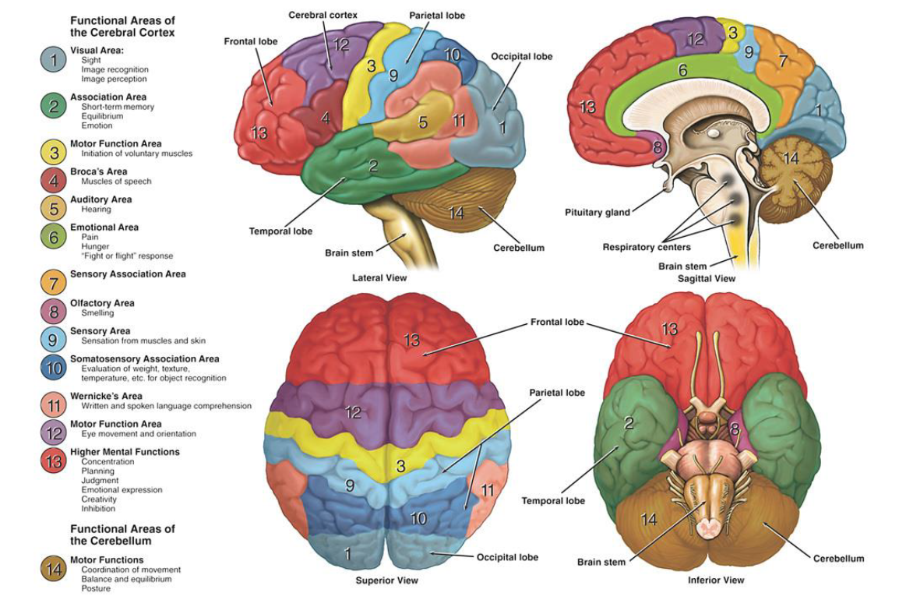
Identify brain functions
EEG can be used all over the brain -different areas of the brain have different functions

Slide 35
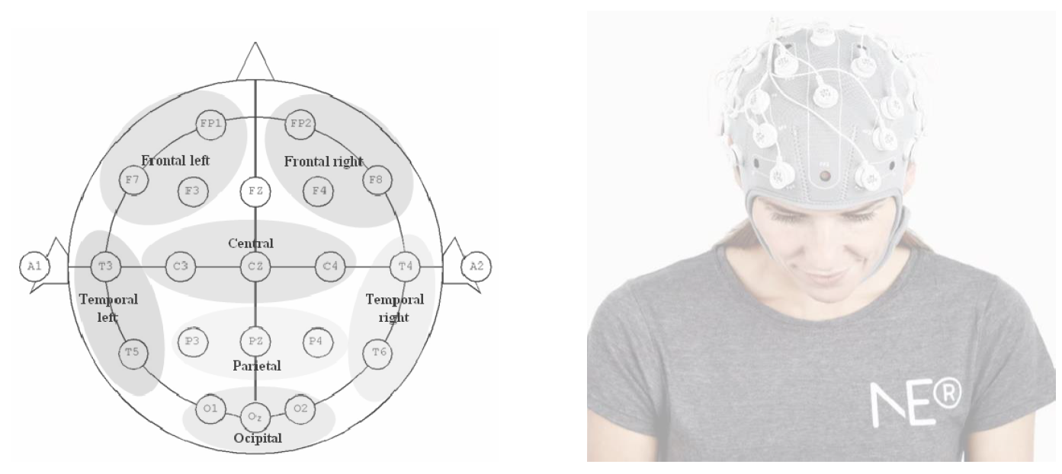
Identify brain functions
EEG can be used all over the brain -different areas of the brain have different functions

Slide 36
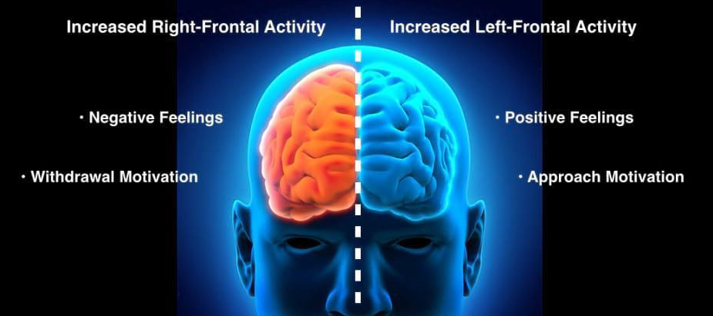
Frontal Alpha Asymmetry (FAA)
Defined as the relative difference in alpha power (8-12Hz) between the frontal left and right hemispheres.
Indicative of approach or avoidance motivation

Slide 37
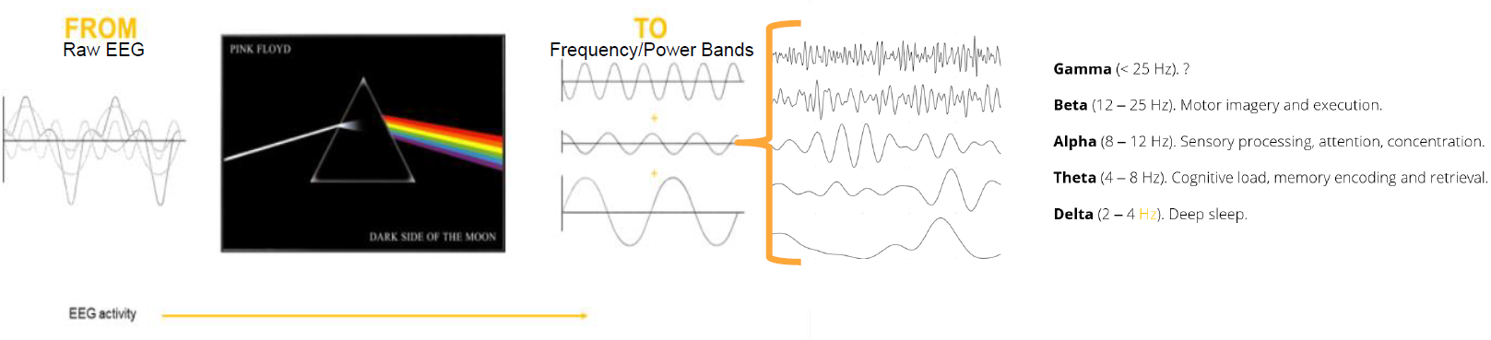
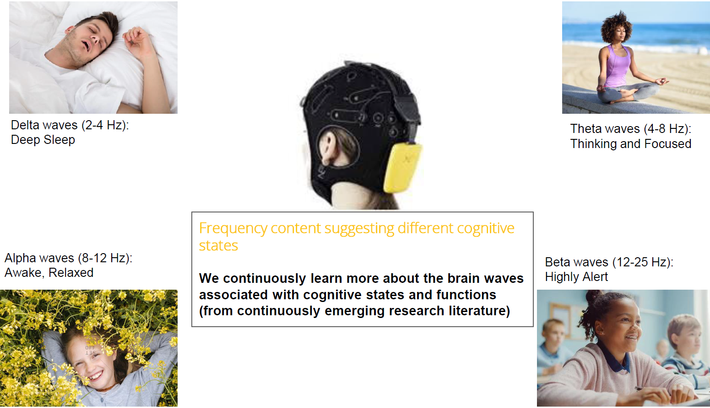
Decoding EEG signals
Breaking down the raw EEG into its frequency components

Slide 38
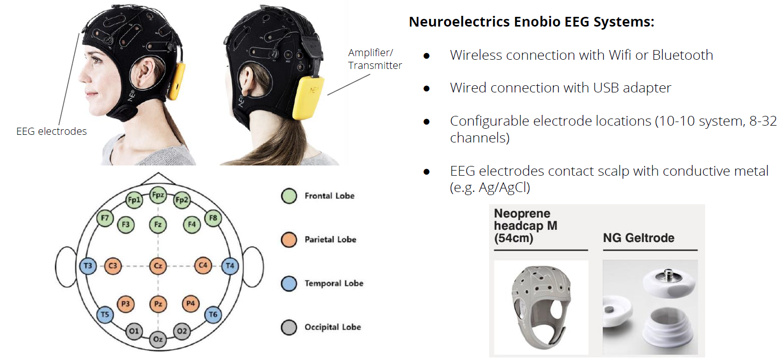
What sensors

Slide 39
Graphs’ interpretation

Slide 40
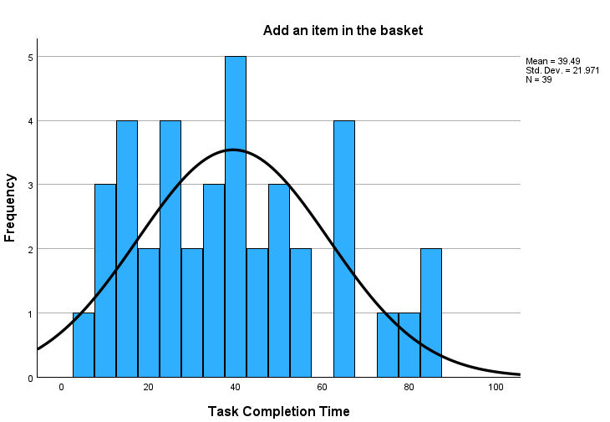
Histogram
The X-axis of the histogram represents the range of values of the task completion time in seconds that users spend to add an item to the basket. It's divided into intervals (bins) of 5.
Y-axis: Represents the frequency, count, or density of data points within each interval on the X-axis. It shows how many data points fall within each range.
Bars: Rectangular bars are drawn above each interval on the X-axis, with the height of each bar indicating the frequency or count of data points within that interval. The width of the bar represents the range of values covered by the interval.
Some other questions you can answer based on the histogram:
  Where is the centre of the data?
  The histogram shows that the centre of the data is around 40 sec?
  What is the spread of the data? What is the range?
  The histogram shows that most of the data is concentrated between 10-55 sec
  What is the shape of the data? For example, is it symmetric, skewed, uniform, or bimodal?
  The histogram shows the distribution of the task completion time within which users added an item to their basket is normally distributed as the shape of the normal curve looks symmetric (this can be confirmed also by the skewness and kurtosis values.
  As a general rule of thumb: If skewness is less than -1 or greater than 1, the distribution is highly skewed. If skewness is between -1 and -0.5 or between 0.5 and 1, the distribution is moderately skewed. If skewness is between -0.5 and 0.5, the distribution is approximately symmetric.
  In case we were comparing two different histograms we could talk about differences in the two (or more) data sets?
  Task Completion Time (M = 39.49, SD = 21.971)
Frequency (or count) of values that fall into each bin
Bin

Slide 41
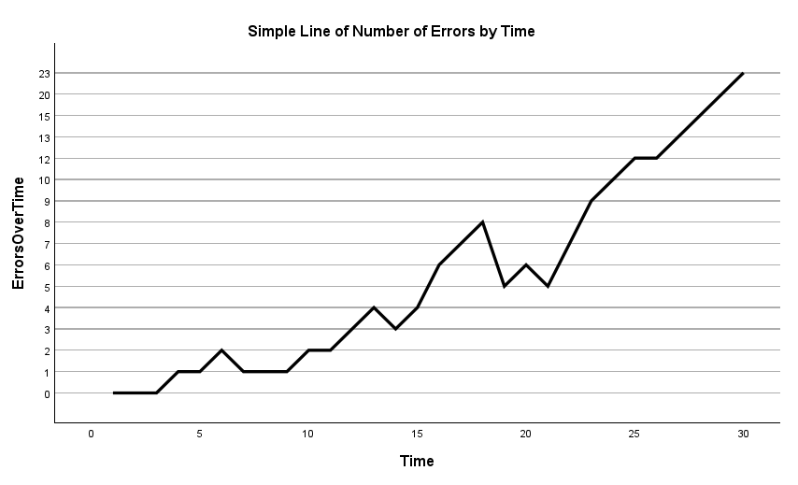
Line graph
The line graph displays the number of errors participants made over the span of 30 minutes time.
X-axis: Represents the independent variable, which is the period of time that users have been observed
Y-axis: Represents the dependent variable, which is the number of errors users did over time.
Data Points: Individual points plotted on the graph, usually represented by markers (dots, circles, squares) at specific coordinates corresponding to the values of the variables being measured.
The line helps visualize the overall pattern, direction (increasing, decreasing), or any fluctuations in the data.
Line graphs are effective in showing trends over time or continuous data and are valuable for:
  Visualizing Trends: Showing how one variable changes in relation to another over a continuous range or time period.
  Identifying Patterns: Revealing patterns, fluctuations, or correlations between variables.
  Highlighting Changes: Highlighting shifts or changes in the data, such as increases, decreases, or trends.

Slide 42
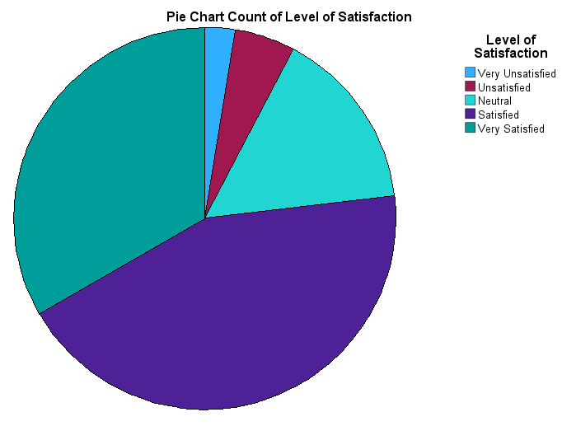
Pie Chart
The pie chart represents the level of satisfaction of users using an e-commerce site ranging from "very unsatisfied" to "very satisfied“. The pie chart represents the distribution of users across these satisfaction levels.
The entire pie represents the total number or percentage of users surveyed.
The pie chart has five segments, each representing the respective percentages of users for each satisfaction level.
33% of users are "very unsatisfied," 44% are " satisfied," 16% are "neutral," 5% are “unsatisfied," and 2% are "very satisfied.“
The "satisfied" segment, being the largest, occupies the most significant portion of the pie, followed by “very satisfied," "neutral," “unsatisfied," and "very unsatisfied" segments in decreasing order of size.
This visualization helps quickly understand the distribution of user satisfaction levels within the surveyed population, highlighting that most of the users were satisfied with the features of the e-commerce site.

Slide 43
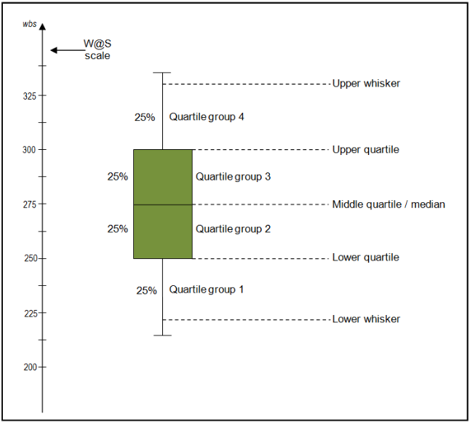
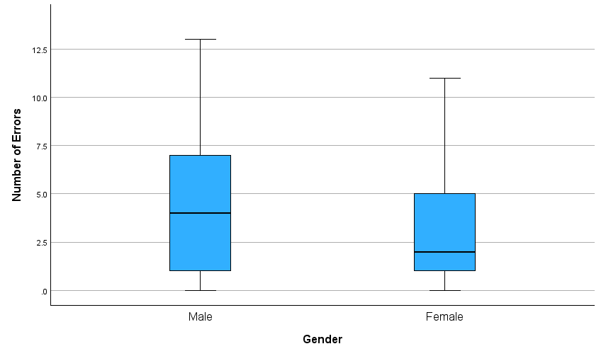
Box plot
The boxplot enables us to study the distributional characteristics of the number of errors among male and female users over a period of time using software.
In both groups (male and female) there is a large distance between the upper quartile and the upper whisker, which suggests that the main concentration of errors was towards the lower range.
The female group box is comparatively short (this suggests that the variance of the number of errors is small). While the male group box is larger (this suggests a larger variance between the upper and lower quartile).
The male box is even in size compared to the female group. Meaning that the median is in the middle between the upper and lower quartile.
In the female box the median is closer to the lower quartile, indicating a possible positive skewness of the data.

Slide 44
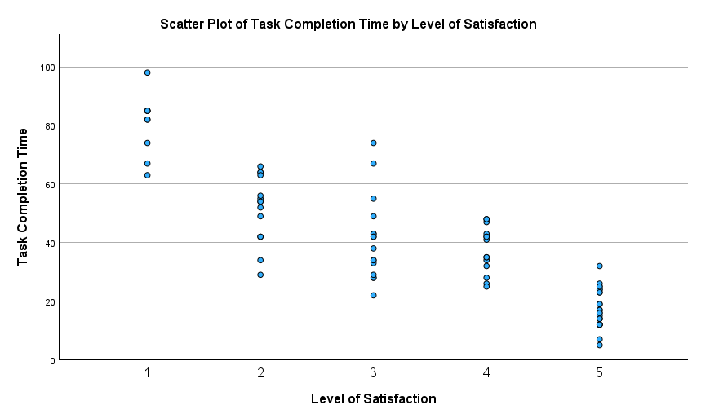
Scatter Plot
A scatter plot is a graphical representation used to display the relationship or correlation between two continuous variables. Each data point on the plot represents both the x-coordinate (time completion of a task) and the y-coordinate (level of user satisfaction).
This scatter Plot demonstrates that as the time completion of a task completion increases, the level of user satisfaction decreases:
The x-axis represents the level of user satisfaction, typically ranging from low satisfaction on the left part of the axis to high satisfaction on the right.
The y-axis represents the time taken to complete a task, with values increasing as you move along the axis (e.g., shorter completion times towards the bottom, longer times towards the top).
The scatter plot shows individual data points for each task completion time and corresponding user satisfaction level. As the completion time increases, the satisfaction level decreases.
The scatterplot shows a visible trend where:
Data points cluster more towards the left (shorter completion times) with higher levels of satisfaction.
As completion time increases (moving towards the right on the x-axis), the data points scatter downwards, indicating a decrease in user satisfaction.
The general trend represented by the scatter plot visually demonstrates a negative correlation between the time taken to complete a task and the level of user satisfaction, highlighting that longer completion times tend to result in lower satisfaction levels among users.

Slide 45
Summary
  We covered ways of capturing user emotions
    Eye Tracking
    Gaze Tracking
    Facial Expression Analysis
    Galvanic Skin Response (GSR)
    Heart Rate Monitoring
    Electroencephalography (EEG)
    Verbal Expressions
  Graph interpretation for
    Histograms
    Line graph
    Pie chart
    Box plot
    Scatter plot

Slide 46
Test your understanding
When to use any of the following techniques to measure emotions?
What sensors do we need
What type of data we collect
What are the implications
  Eye Tracking
  Gaze Tracking
  Facial Expression Analysis
  Galvanic Skin Response (GSR)
  Heart Rate Monitoring
  Electroencephalography (EEG)
  Verbal Expressions

Slide 47
Reading
Tullis, T. (Thomas) et al. (2013) Measuring the user experience : collecting, analyzing, and presenting usability metrics. 2nd ed. Amsterdam, Netherlands: Elsevier.
  Chapter 2 Background (graphs)
  Chapter 7 Eye tracking
  Chapter 8 Measuring Emotion

